Slide 1
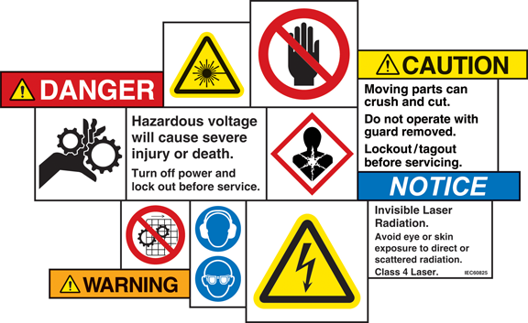
higher Design & Manufacture
Performance and Safety

Slide 2
Learning intentions & success criteria
Learning Intentions
Introduction to the design factors of performance and safety.
Success Criteria
Describe and explain the different criteria of performance in relation to a product.
Describe and explain the safety aspects of product design.

Slide 3
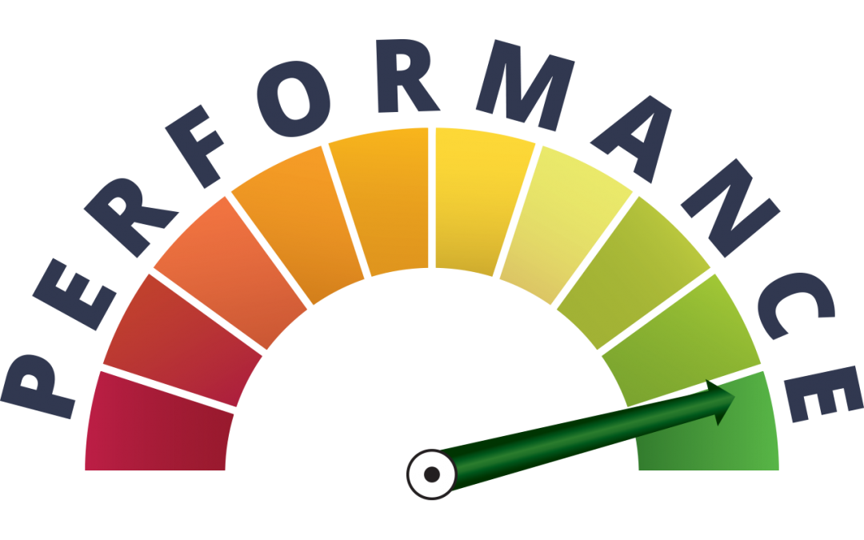
performance
Performance is about how well a product fulfils its purpose – how it performs and how well it works.
It can be divided into a few main areas:
Ease of Maintenance
Value for Money
Materials & Manufacturing
Planned Obsolescence
Safety

Slide 4
Ease of maintenance
Maintenance keeps a product working smoothly and safely.
It will enable the user to:
Keep their product in good working order
Extend the life of the product
The level of skill required to maintain a product should be considered carefully during the development of a product.

Slide 5
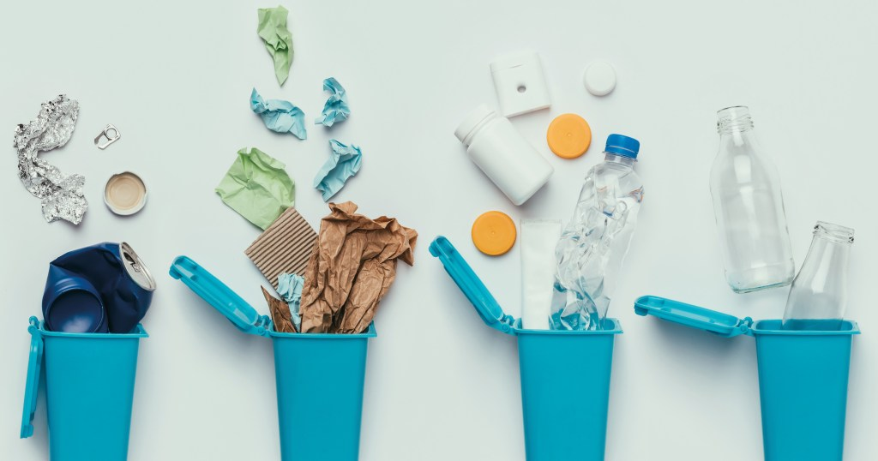
Ease of maintenance
Products that are easy to maintain are less likely to be thrown away.
This is a major benefit for the environment.
However, products that can be maintained indefinitely reduce the potential for repeat purchases, thus limiting the profit for companies

Slide 6
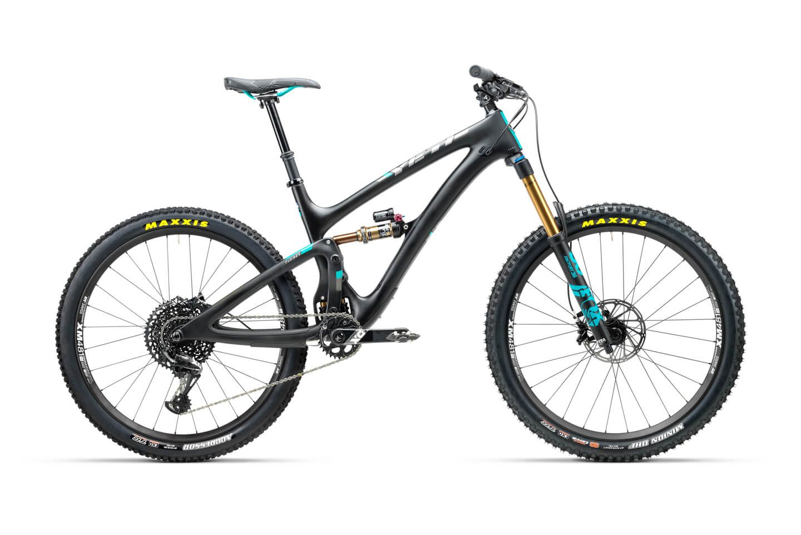
Ease of maintenance
During the design of a product the designer should consider different aspects of maintenance.
Who is likely to carry out maintenance?
Example: high-end mountain bikes are likely to be purchased by enthusiasts with a fair degree of skill and specialist tools.
Cheaper bikes may only require cleaning tasks and tightening of bolts etc.
Regardless of skill level: it is good practice to design to ensure that any maintenance is as simple as possible to carry out.

Slide 7
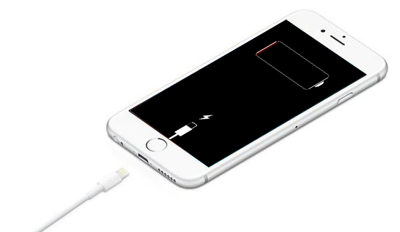
Ease of maintenance
What type of maintenance should be carried out?
Consideration must be given to the nature of the maintenance tasks.
Examples:
Will the product need to be charged?
Will the product need to be filled/emptied/adjusted?
Will parts need replaced?
The designer must ensure that access to perform these tasks is included in the design.

Slide 8
Value for money
All consumers want value for money.
Companies attempt to design and manufacture products that are perceived as being better value, even when similarly prices to competitors.
To ensure a ‘good value for money’ perception is achieved, the designer must take the expectations of the target market into account.

Slide 9
Value for money
Designers will research expectations prior to forming a specification and will try to find out:
What functions the market expects the product to perform
Which performance criteria are most important to the market
How long the market expects the product to last
With these points in mind, the designer must strike a balance between fulfilling the customer’s expectations and keeping costs to a minimum.

Slide 10
Value for money
Consideration must also be given to:
The selection of materials
The manufacturing processes
These must be affordable to allow a profit.
Consumer must believe that the product has been well manufactured from quality material
Today, consumers are better informed than ever: access to online reviews, social media, user’s opinions, product comparisons etc.

Slide 11
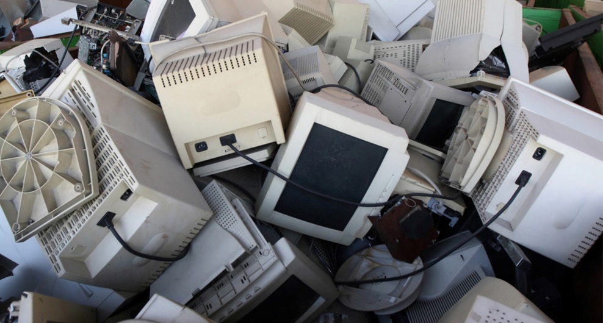
Planned obsolescence
Products are not designed to last indefinitely.
There are obvious reasons for this:
Financial implications in the form of material and manufacturing costs
Difficult to dispose of
Likely to become unfashionable after a while
Best interest of the company to encourage consumers to make repeat purchases to increase sales volumes

Slide 12
Planned obsolescence
Planned obsolescence is a strategy used in the design of products to give a product a specific lifespan.
This is to cause the product to be perceived as obsolete before it actually needs to be replaced.
This encourages the consumer to purchase another version of the same product before it is needed.
e.g. releasing a new version with some additional features that aren’t key.

Slide 13
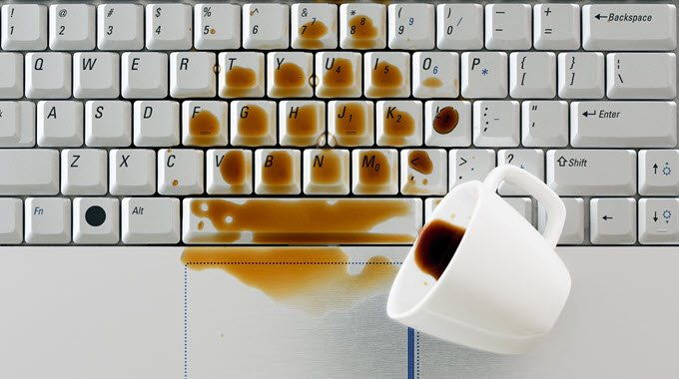
Planned obsolescence
Style Obsolescence
Products designed to be fashionable on their release are likely to fall out of fashion within the next few years.
Product Evolution
Increasing rate of technological developments has resulted in a steady stream of newer models e.g. mobile phones and tablets
Ease of Maintenance
Lifespan of a product is influenced by how easy it is to maintain

Slide 14
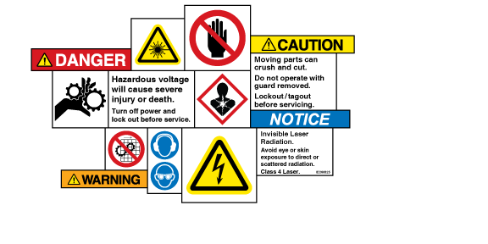
safety
Safety is paramount for all products in their:
Design
Manufacture
Use
Disposal
Designers have a key role to play identifying and eliminating potential hazards and reducing possible risks from hazards if elimination is not possible.

Slide 15
Safety during Design development
Safety during design and development
Designers must consider how the product will be used
Understand how it could be misused
Selection of materials, finishes, ergonomic aspects, instructions and the user interface are just some of the aspects the designer may consider
Ensure the product is designed within regulations e.g. BSI and CE.
Rigorous testing can be carried out during development using machines and in extreme environments

Slide 16
Safety during manufacture
Safety during the manufacture
The production should be safe for those involved
Manufacturers need to protect workers from repetitive strain, gasses, fumes, falling objects, noise etc.
This can be achieved by maintaining machines, signage, training, alert systems, regular breaks, adequate lighting and use of PPE (personal protective equipment).
E.g. eye protection, hard hats, gloves, masks, etc.

Slide 17
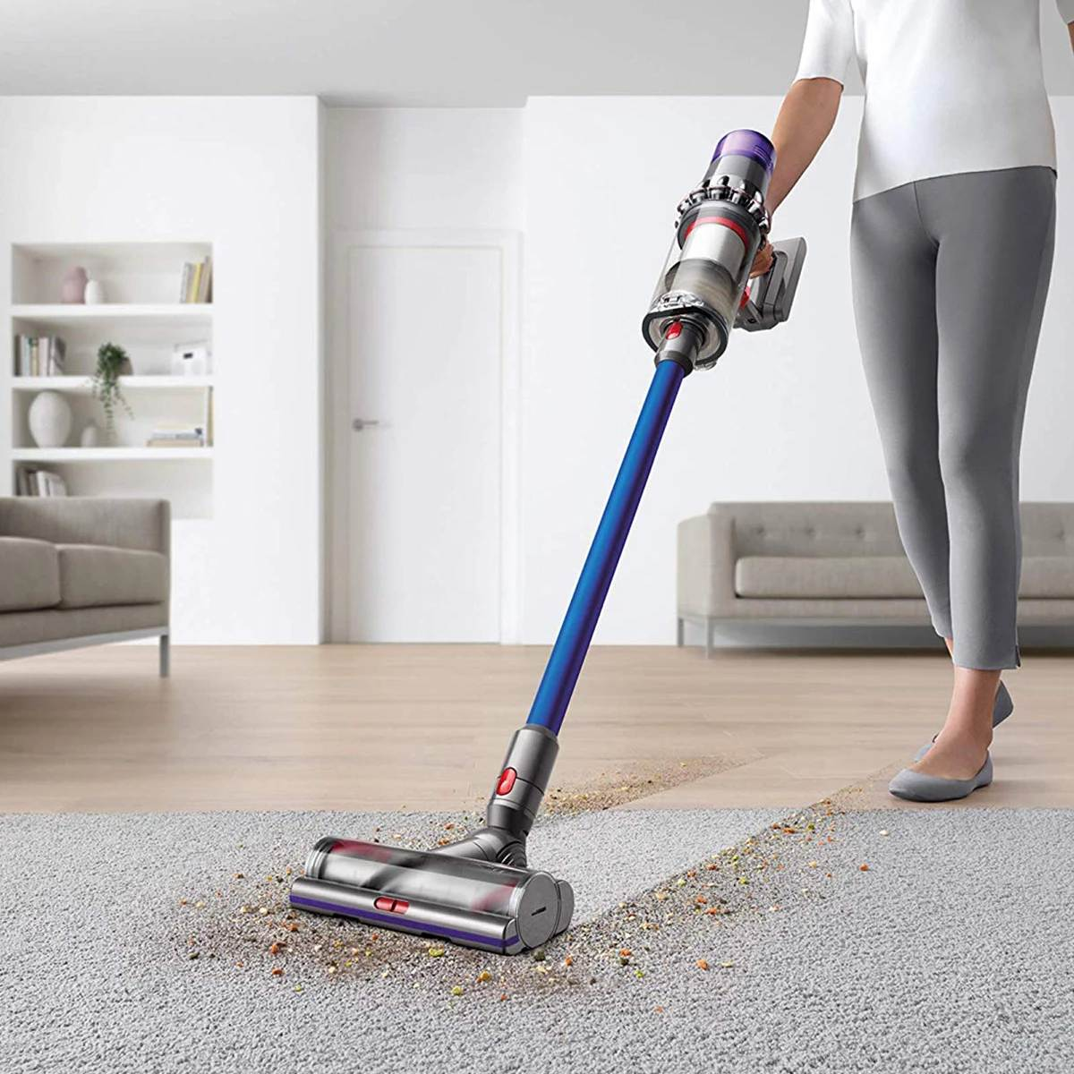
Safety during Consumer use
Safety for consumer use
The product should be easy to understand
Where risks cannot be eliminated, warnings should be clearly visible to alert the user of potential risk
Materials chosen should not cause any harm
Operation of the product should not cause any harm
Any special requirements related to the use, maintenance or disposal of parts should be clearly shown

Slide 18
Safety at the End of life
Safety and end of life
It is the designer’s responsibility to consider any risk to society or the environment that may be caused by the disposal of the product
Designers must ensure products can be dismantled safely for disposal
Any toxic parts must be protected in sealed units to guard against accidental access

Slide 19
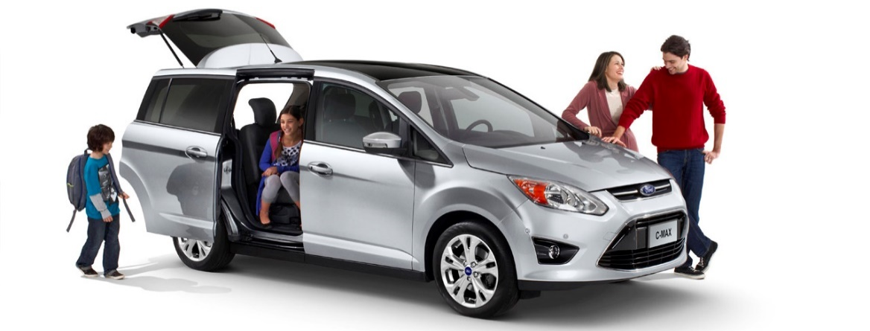
Task 1
Safety and the Family Car
Consider a typical family car
Explain how safety considerations have influenced the design of the car
Come up with at least 10 points
For example, one aspects might be the speed at which the windows open and close. A slower speed would prevent the glass from shattering and potentially reduce the risk of people getting their fingers caught.

Slide 20
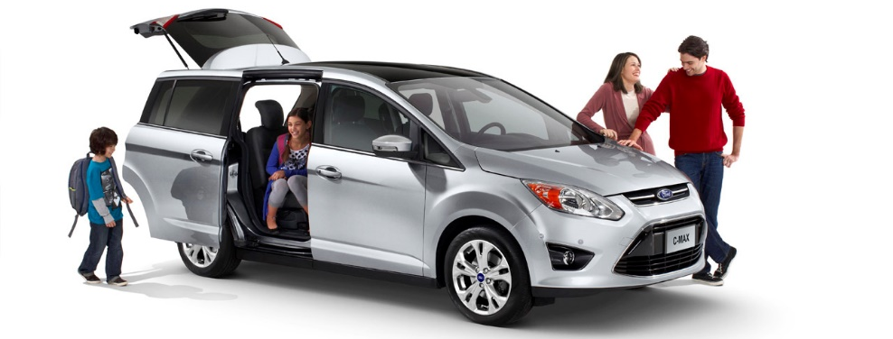
example answers
Airbags (safety)
ABS (Anti-lock Braking System)
Seatbelts (safety)
Rubberised Interior (safety)
Sensors e.g. Parking Assist, Collision, Tyre Pressure
Shatter-resistant glass (injury)
Lights (adaptive)
Mirrors (safety checks)
Bumpers (plastic)
Four Wheel Steering (control)
Crumple Zones (sacrificial)
Tyre Traction Patterns (better grip)
Tactile Buttons/Dials/Knobs (easily reached without looking)
Child’s Seat Anchors

Slide 21
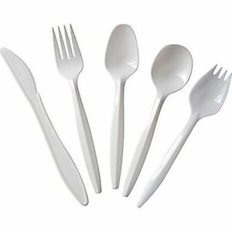
Task 2
Create a list of 5 products you can think of that you have purchased more than once.
*Do not include consumables e.g. food.*
Identify the products you think are designed with planned obsolescence in mind.
Explain why you think this is the case for each product.

